Slide 1
Arithmetic Operations
Python Lesson 2: by Rachael Sera

Slide 2
Review - Data types
Data is used and stored as particular “types”
We’ve worked with
ints (integers - whole numbers)
floats (floating point - decimal numbers)
strings (characters wrapped in quotation marks)

Slide 3
Review - Data types
What data types are these variables (choose from: string, int, float)?
length = 5
result = 5+3
radius = 2.5
animal = “cat”
answer = result
size = “5”

Slide 4
Review - IO Functions - print
print()
“Arguments” go inside parentheses; separate arguments with a comma
print(“The answer is”, ans)
Two arguments in the above example; one string and one variable

Slide 5
Review - IO Functions - input
input()
Always store the return value in a variable
Add a message to the user inside quotes inside the parentheses
name = input(“Please enter your name”)
“Cast” the return value of input if you want something other than a string
length = int(input(“Please enter the length”))

Slide 6
Arithmetic Operators
Standard Operators
+ addition
- subtraction
* multiplication
/ division

Slide 7
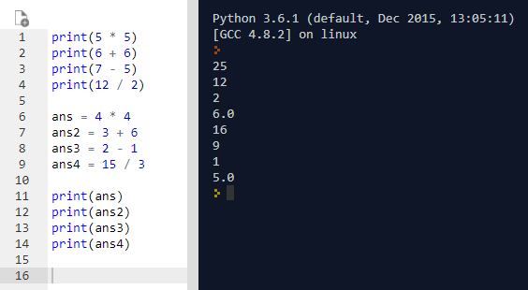
Standard Math Operations
Gotta print it so we see the answer!
Print the result
Or store the result in a variable and print the varaible

Slide 8
Variables
More motivation for variables:
Used variables to store the value the user entered as input
Variables allow us to run the same code with different values
Write a formula and plug different values into it

Slide 9
Example 1: Calculating Area
Write a program to calculate the area of a rectangle:
length = 5
width = 10
area = length * width
print(area)

Slide 10
Example 1: Printing a longer message
Area of a rectangle:
length = 5
width = 10
area = length * width
print("The area of a rectangle with length”, length, “and width”, width, “is”, area)

Slide 11
Example 1: User input
Area of a rectangle:
length = int(input(“Enter the length”))
width = int(input(“Enter the width”))
area = length * width
print("Length:", length, "Width:", width, "Area:", area)

Slide 12
Solving equations
You can solve equations for other variables:
area = length * width
length = area / width

Slide 13
Example 2: Tax calculator
Write a program that calculates the total cost of an item with tax, given the item’s cost and the current tax rate.

Slide 14
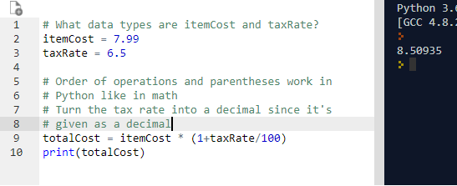
Tax Calculator
To solve this problem, you need to convert the tax rate from its percent value into its fractional value
(6.5 % = 6.5/100 = .065)
Use parentheses in Python for order of operations

Slide 15
More Arithmetic Operators
Special Operators
** exponentiation
// integer division
% modulus (mod)
Notes:
Go to whiteboard

Slide 16
Exponentiation
base ** power
2**0 = 1
2**1 = 2
2**2 = 4
2**3 = 8
2**4 = 16

Slide 17
Integer division
Integer division is the whole number result of the division
(no remainder)
4//2 = 2
10//2 = 5
3//2 = 1
7//2 = 3
5//1 = 5
5//2 = 2
5//3 = 1
5//4 = 1
5//5 = 1
5//6 = 0

Slide 18
Modulus (mod)
The modulus is the remainder after you perform division
4%2 = 0
10%2 = 0
3%2 = 1
7%2 = 1
7%5 = 2
5%1 = 0
5%2 = 1
5%3 = 2
5%4 = 1
5%5 = 0
5%6 = 5
Notes:
Note that even numbers mod by 2 = 0 and odd numbers mod 2 = 1

Slide 19
Example 3: Cupcakes
You are buying cupcakes for friends. You want to split the cupcakes evenly among the friends. No one wants to eat half a cupcake, so the number of cupcakes per person should be a whole number. Write a program to determine how many cupcakes each person gets, and how many are left over. Get user input for the number of cupcakes and number of friends.

Slide 20
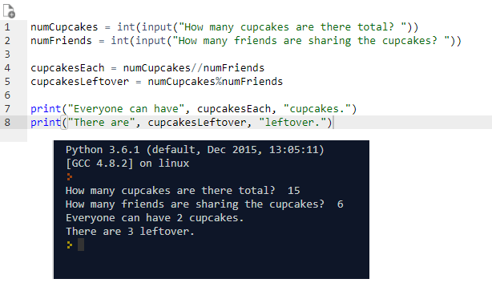

Slide 21
Libraries
Libraries allow us to use pre-written functions
Two useful ones: random and math
Random
Allows us to generate random numbers
Math
Allows us to perform math operations and get math constants
pi, sqrt
To use a library, you must “import” it at the top of your program

Slide 22
Simple Random Example
import random
num = random.randint(1,6)
print(num)
Notes:
Vary bounds

Slide 23
Math Library Example
import math
radius = 3
area = math.pi * radius ** 2
print(area)

Slide 24
import math
num = 9
root = math.sqrt(num)
print(root)

